Slide 1

IKT442
Drone simulation
By
Martin Holen

Slide 2
Introduction
This project aims to create a simulation with an environment made for Artificial Intelligence (AI) Agents.
The simulation focuses on drones to foster testing of algorithms made for flying.
Unlike many other simulations, having free and open source software is important.

Slide 3
Unity - Overview
Unity is an widely used game engine, which is cross platform.
Unity has a free version of its software.

Slide 4
Unity – Creation of agent
Unity allows for quick and easy creation of agents, using simple shapes.
The agent is then programmed to react to key presses, and physics is added.
After which its view is set, and programmed to follow the agents movement.

Slide 5
Unity – Agent Motion
To create the force on the drone, offsets are created for each wing.
An Int representing the force is also set.
Then the checks for each key is created
Which uses a function to add the force
void FixedUpdate()
{
if (Input.GetKey("w"))
{
AddForceToRotor(directionalforce, (rb.transform.rotation * _backLeftRotor) + bL.transform.position);
AddForceToRotor(directionalforce, (rb.transform.rotation * _backRightRotor) + bR.transform.position);
}
Private void AddForceToRotor(float speed, Vector3 rotor)
{
rb.AddForceAtPosition(speed * transform.up * Time.deltaTime, rotor);
}

Slide 6
Unity – Camera Motion
using UnityEngine;
public class CameraController : MonoBehaviour {
public GameObject chopper;
private Vector3 offset;
void Start () {
offset = transform.position - chopper.transform.position;
}
void LateUpdate () {
transform.position = chopper.transform.position + offset;
}
}
Creates an offset on start of the simulation
And it moves the camera in the same way as the agent, staying at the same offset

Slide 7
Unity – Creation of environment
Unity allows for environment to be created using the 3D object terrain.
The terrains shape can then be changed.
This change of terrain shape can be useful when the drone is able to navigate its environment
Then a reward is calculated from where the drone is relative to the goal

Slide 8
Unity – environment Automater
Random variable created at the start
Then taking the inputs of depth, width, breadth and scale, the terrain is created. After calling the function which calculates the height at each point.
This height is calculated using the random variables
void Start() {
offsetX = Random.RandomRange(0f, 9999f);
offsetY = Random.RandomRange(0f, 9999f);
}
terrain.terrainData = GenerateTerrain(terrain.terrainData);
TerrainData GenerateTerrain(TerrainData terrainData){
…
terrainData.SetHeights(0, 0, GenerateHeights());
}
float[,] GenerateHeights() {
…
heights[x, y] = CalculateHeight(x, y);
}
float CalculateHeight(int x, int y)
{
float xCoord = (float)x / width * scale + offsetX;
float yCoord = (float)y / bredth * scale + offsetY;
return Mathf.PerlinNoise(xCoord, yCoord);
}

Slide 9
Free software
Unity has a free version, which allows anyone to use it.
Many other simulations are not free.
Those simulations that are free, may not suit your need.

Slide 10
Opensource
Some of the programming which was done, was done on opensource software.
Python libraries were opensource
Unity had some opensource, with the other libraries being native

Slide 11
Autonomous Vehicles - Overview
The model is made in keras.
Many different components needed.

Slide 12
Autonomous vehicles - Grabscreen
Made by someone only referred to as Frannecklp.
Grab_screen is a script which uses win32gui, win32ui, win32api.
It finds the screen, saves it into memory.
Then converts it into bitmap, checks that the size is compatible.
Then returns it as RGB.

Slide 13
AUTONomous vehicles – keyboard simulation
The code for the keyboard simulation is done by Daniel Kukiela (https://twitter.com/daniel_kukiela).
It translates each keypress into hexadecimal codes.
Then it applied those keys using a C-library.

Slide 14
AUTONomous vehicles – OCR
The OCR or object character recognition, uses pytesseract.
Pytesseract is a python wrapper for one of googles OCR engine.

Slide 15
Autonomouse vehicles - MODEL
The Artificial Intelligence model used, is based on ALVINN.
It is implemented in Keras.
The model is a Q-learning model using three fully-connected layers.
It takes the OCR, and grabscreen scripts as inputs.
And uses the Keyboard simulation to interact with the environment.

Slide 16
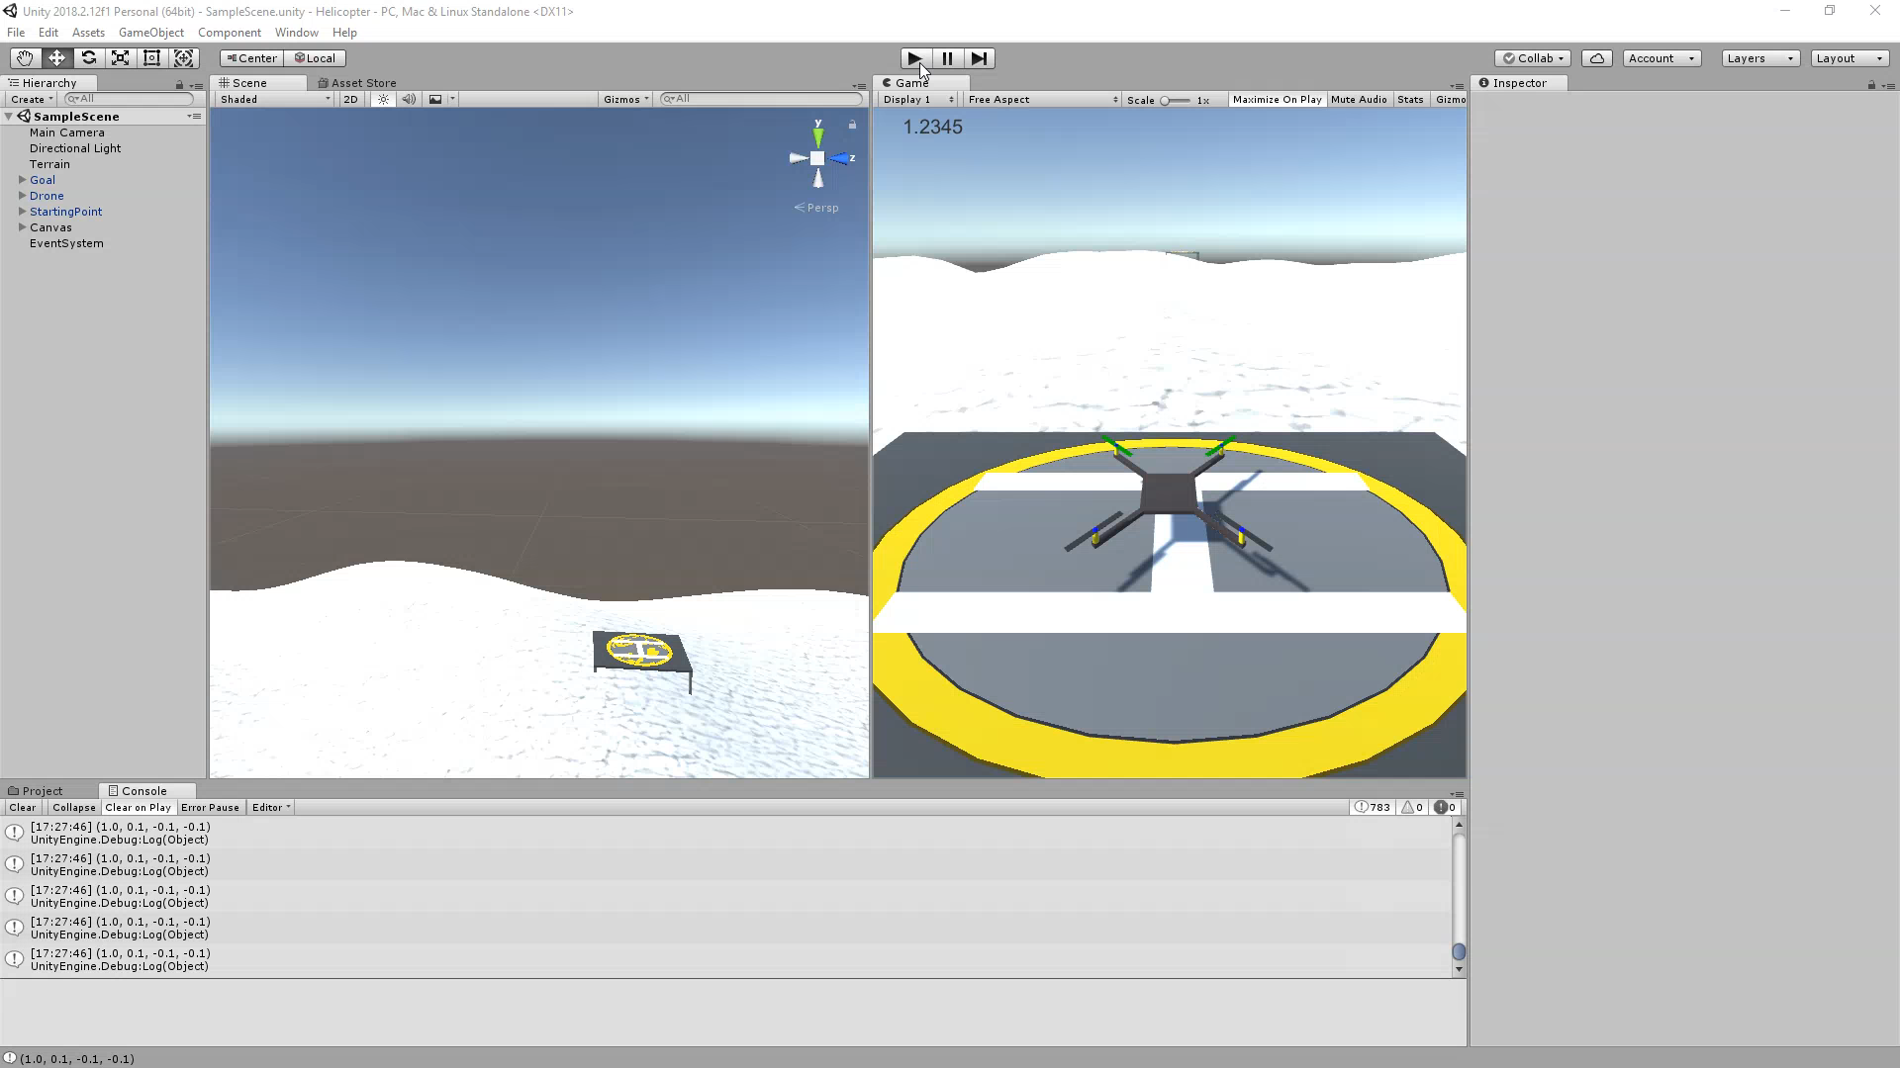
Demo - 1

Slide 17

Demo - 2

Slide 18
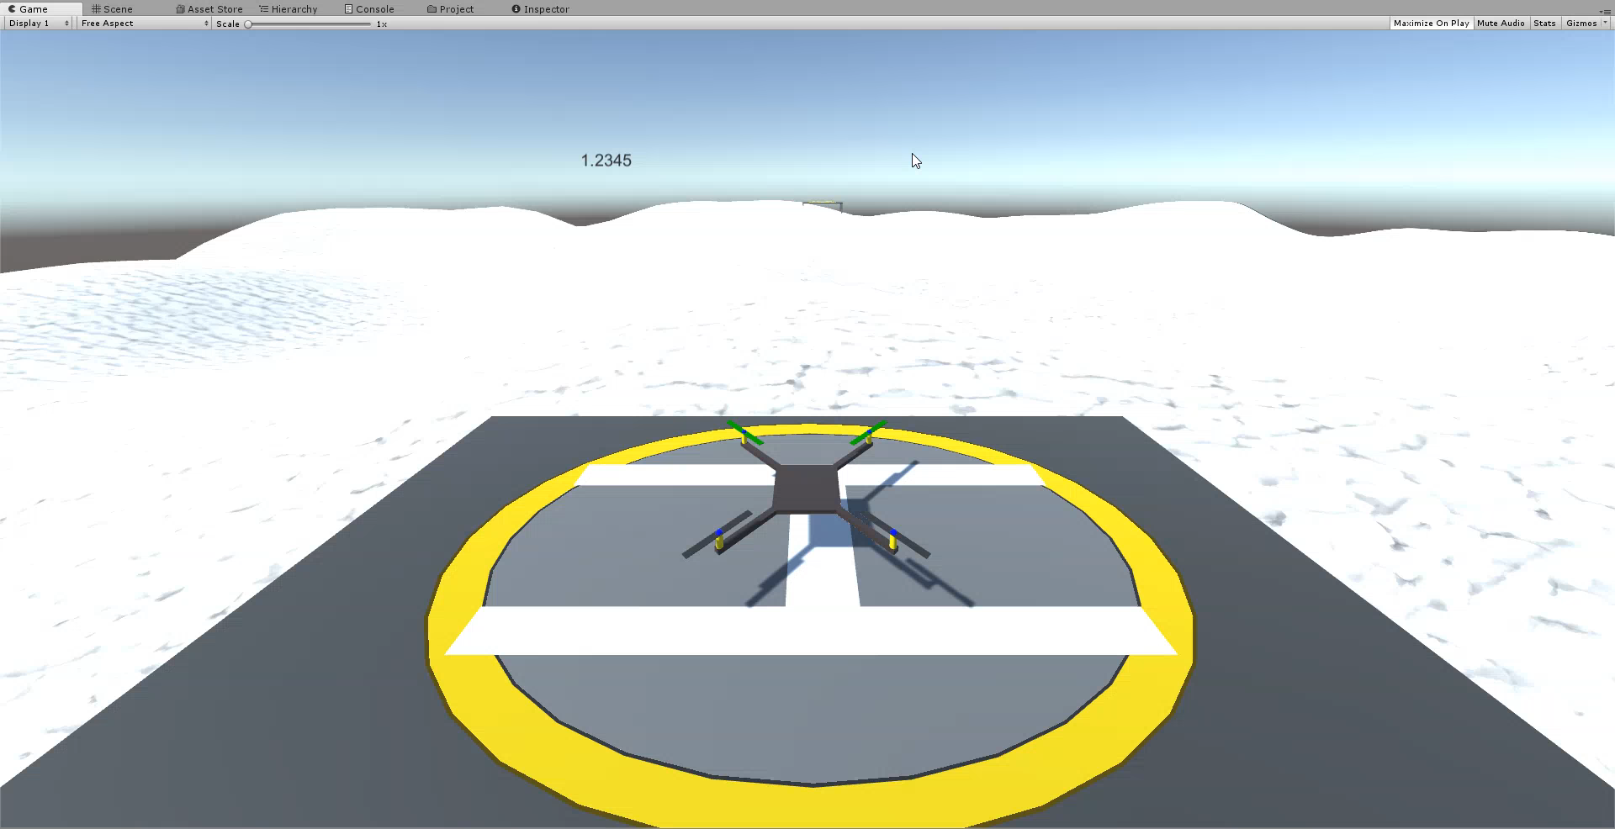
Demo - 3

Slide 19
Thank you

